Slide 1
LESSON 8.2
Calorimetry

Slide 2
LESSON GOALS
I can apply the equations Q = mcΔT and ΔH = -Q/n in the calculation of the enthalpy change of a reaction

Slide 3
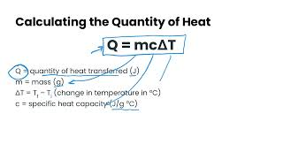
TASK 1: LEARN (MUST DO)
Watch the Specific Heat Capacity video
Complete the appropriate section of the guided note

Slide 4
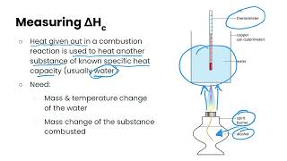
TASK 2: LEARN (MUST DO)
Watch the Measuring Enthalpy Changes of Combustion video
Complete the appropriate section of the guided note

Slide 5
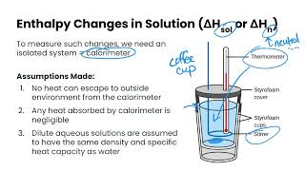
TASK 3: LEARN (MUST DO)
Watch the Measuring Enthalpy Changes of Solution video
Complete the appropriate section of the guided note

Slide 6
TASK 4: PRACTICE
Complete the calorimetry practice (answers included)
Note: There are must do, should do, and aspire to do questions included in this practice!

Slide 7
TASK 5: MASTERY CHECK (MUST DO)
Complete the calorimetry mastery check (see me when you are ready!)

